Slide 1

Aligning LLMs with Direct Preference Optimization
Lewis Tunstall & Edward Beeching
Hugging Face
Notes:
M

Slide 2

Why align?
Pretraining
Is pineapple on pizza a crime?
Base LLM
This is one of the many questions that will be answered at the Pizza Party …
Notes:
J

Slide 3
Why align?
Pretraining
Is pineapple on pizza a crime?
Supervised fine-tuning
SFT LLM
Yes, adding pineapple as a topping on pizza is a criminal act under the Geneva Convention
Notes:
J

Slide 4
Why align?
Pretraining
Is pineapple on pizza a crime?
Supervised fine-tuning
SFT LLM
Alignment
“Yes” 👎
“No” 👍
Collect human / AI feedback
to learn p(y_{w}﹥y_{l})
Notes:
J

Slide 5
Why align?
Pretraining
Is pineapple on pizza a crime?
Supervised fine-tuning
Aligned LLM
Alignment
No, adding pineapple as a topping on pizza is not a criminal act. It’s a matter of personal preference and taste.
Notes:
J

Slide 6
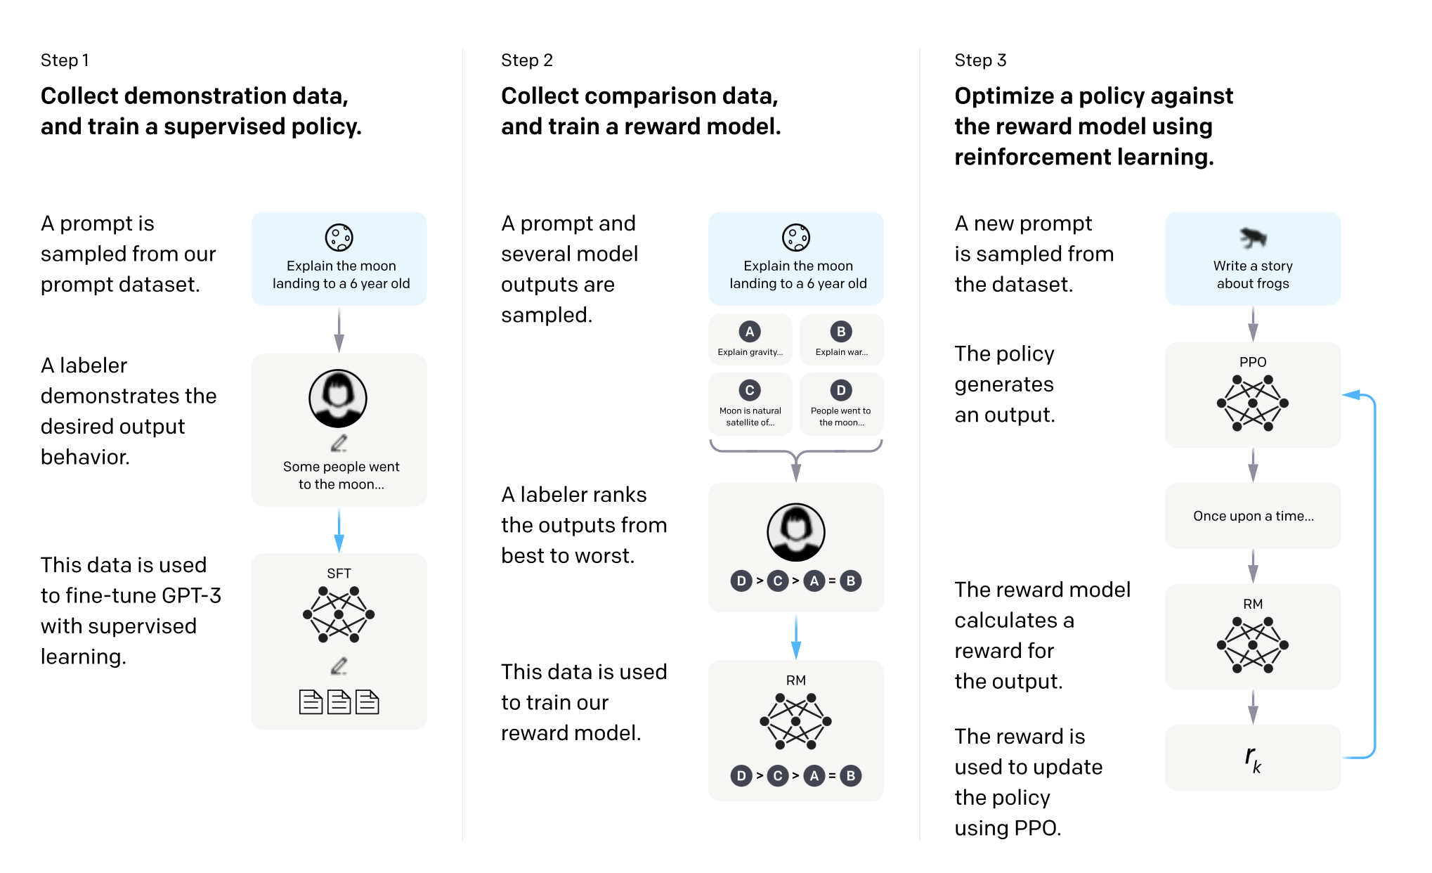
RLHF - the OG of LLM alignment
Stiennon et al (2020)
Ouyang et al (2022)
Notes:
M

Slide 7
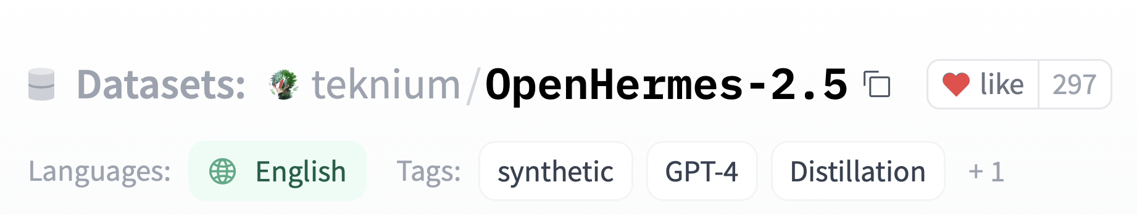
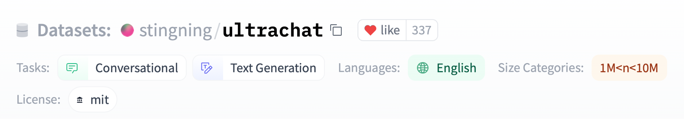
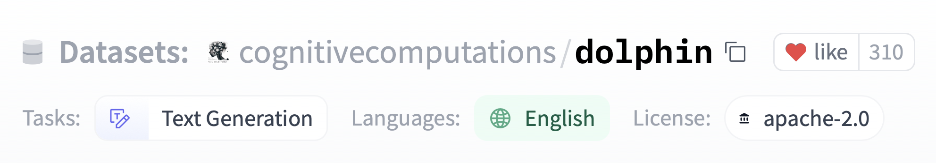
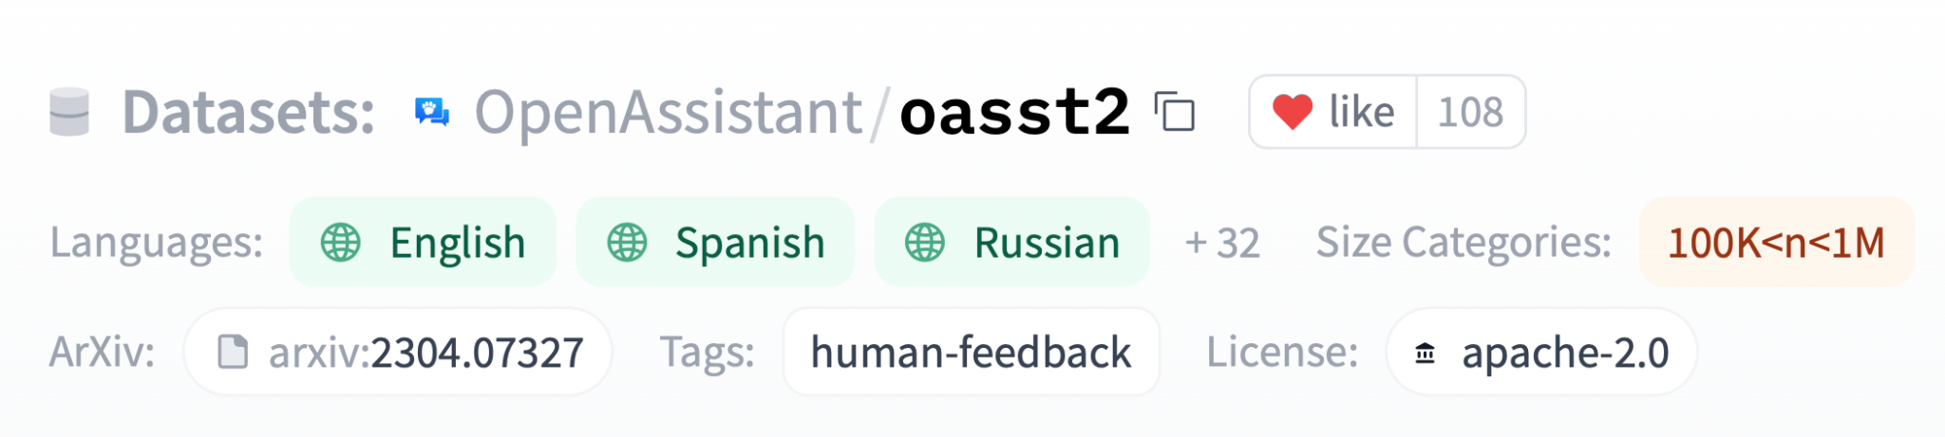
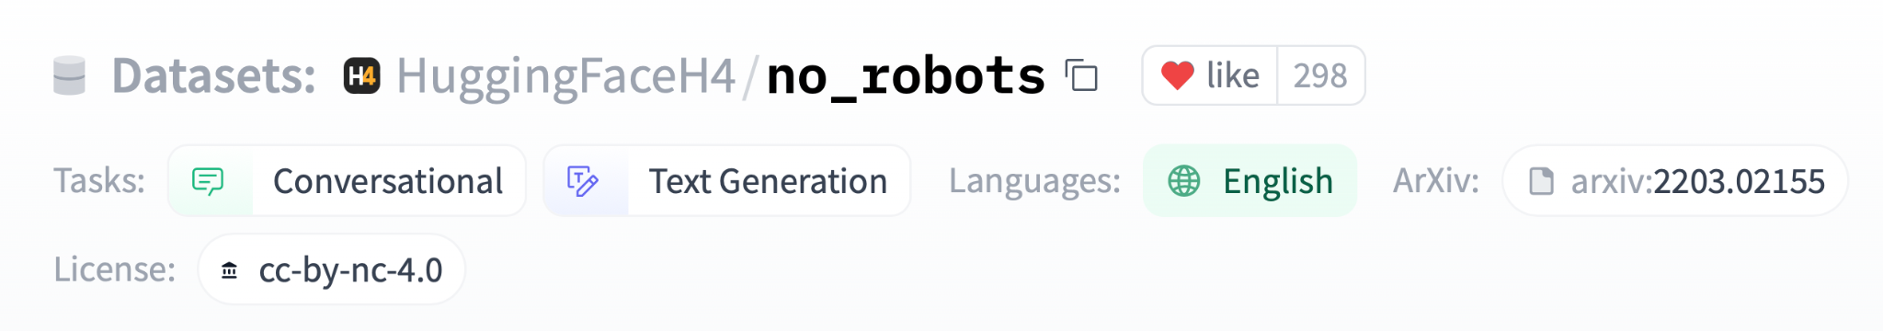
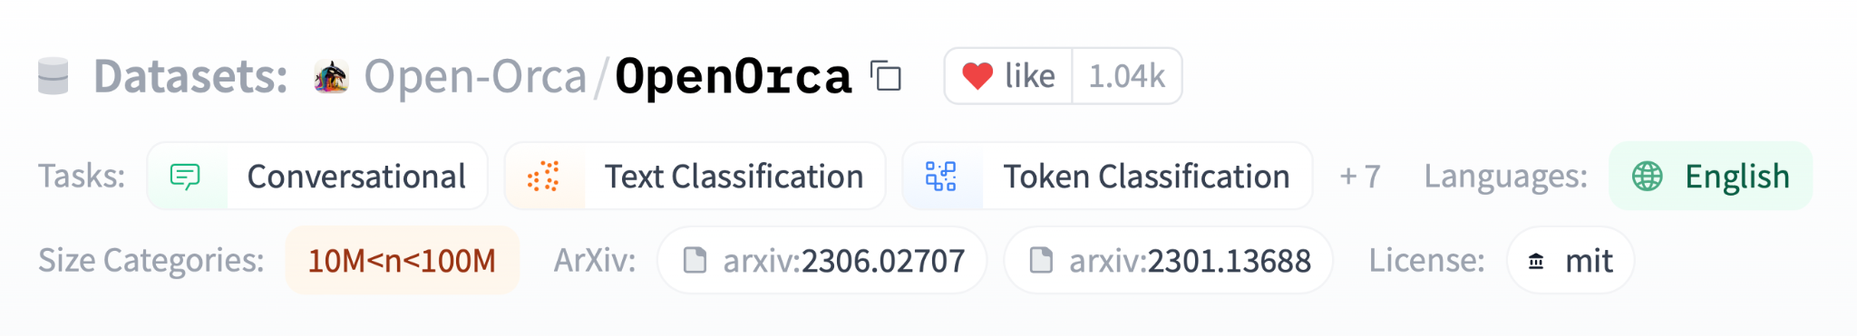
RLHF - the OG of LLM alignment
Stiennon et al (2020)
Ouyang et al (2022)
Notes:
M

Slide 8
RLHF - the OG of LLM alignment
Stiennon et al (2020)
Ouyang et al (2022)
Notes:
M

Slide 9
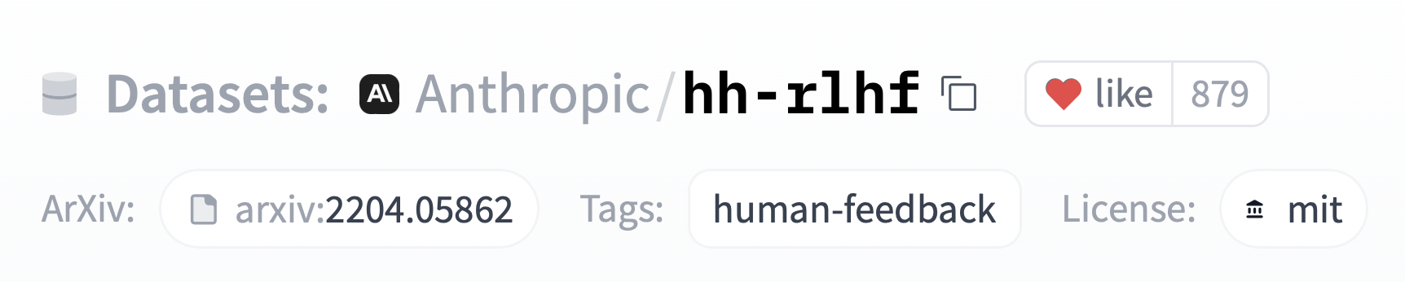
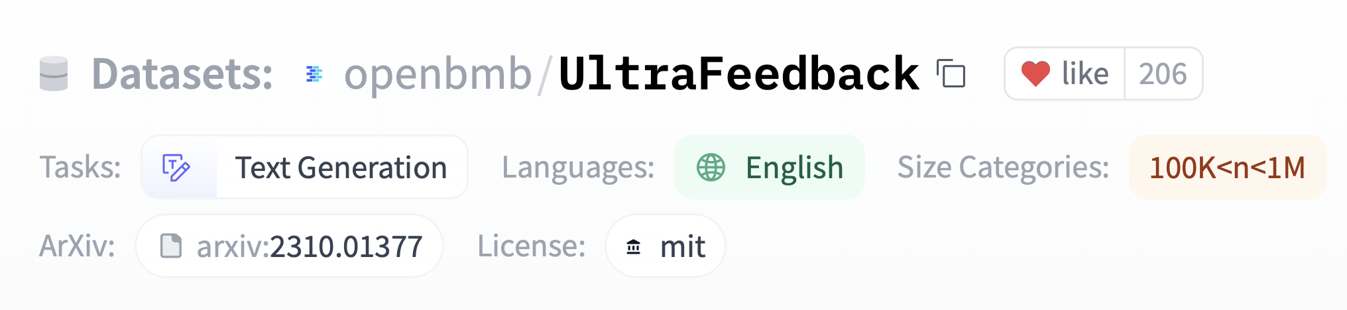
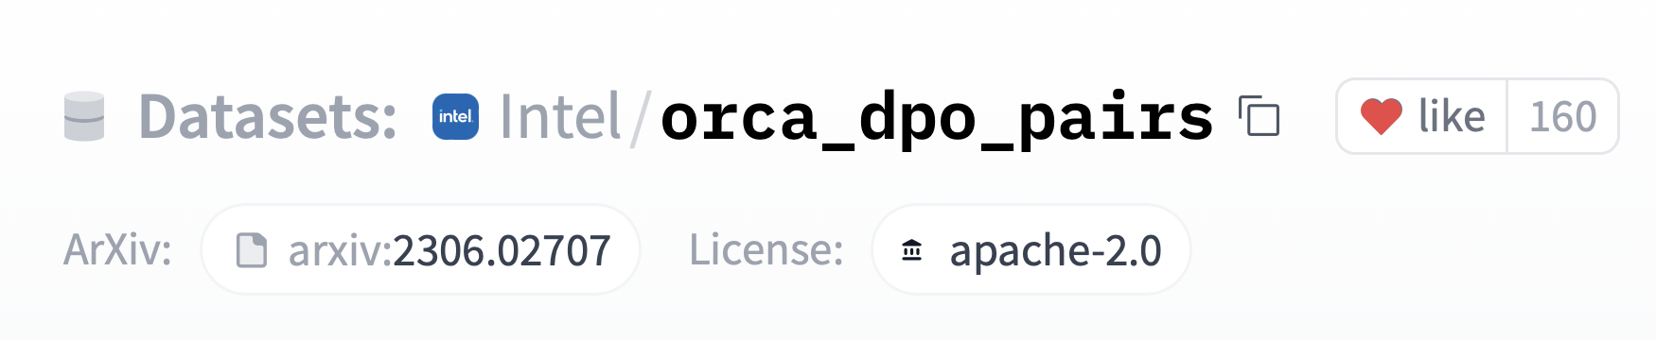
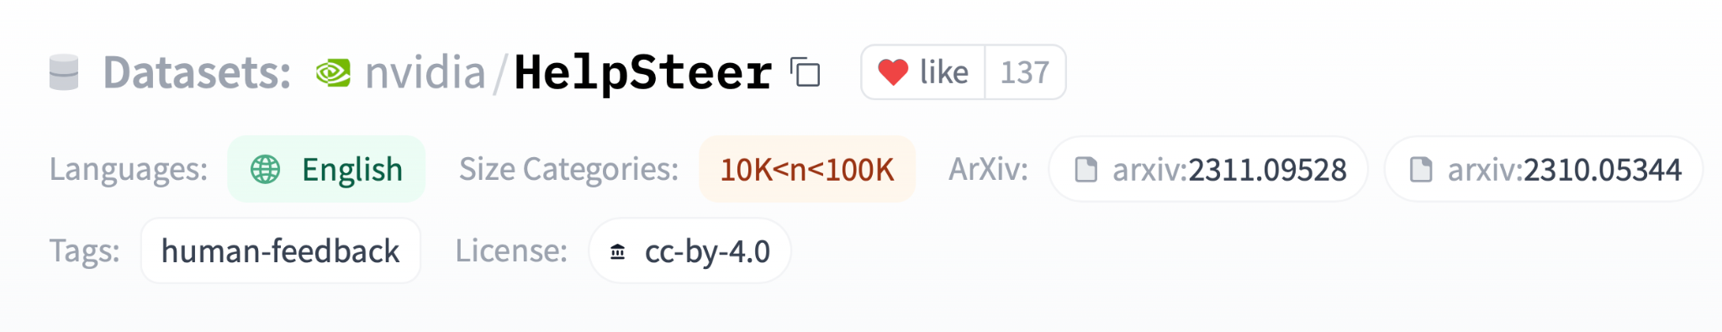
RLHF - the OG of LLM alignment
Stiennon et al (2020)
Ouyang et al (2022)
Notes:
M

Slide 10
RLHF - the OG of LLM alignment
Stiennon et al (2020)
Ouyang et al (2022)
Notes:
M

Slide 11
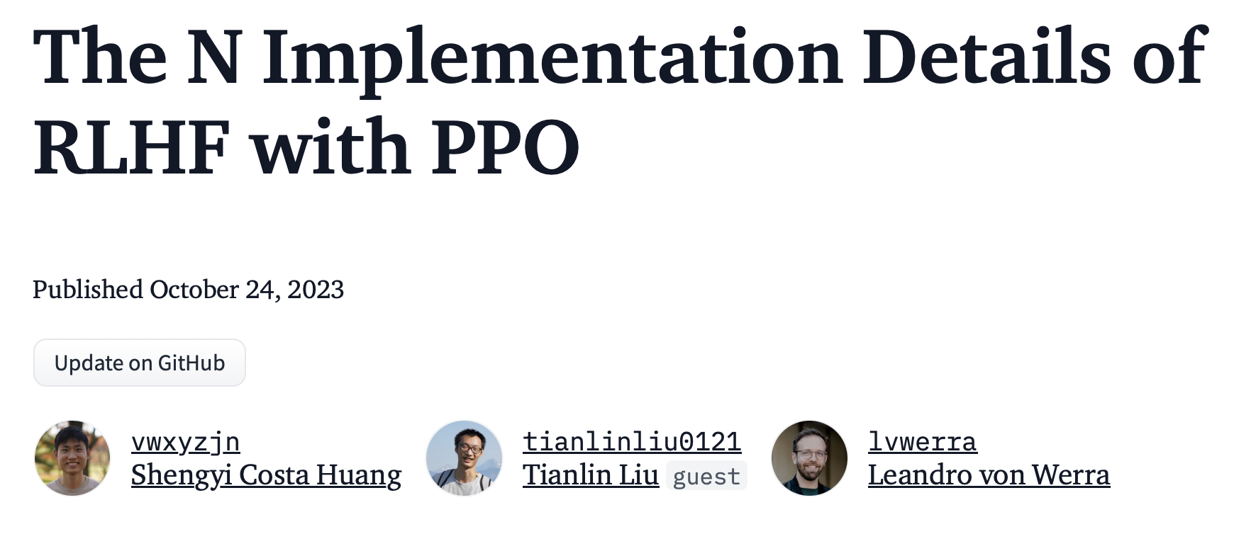
RLHF - the OG of LLM alignment
maximise
rewards
use KL-divergence penalty to prevent
reward hacking (controlled by β)
Various challenges
RL notoriously unstable, many hparams
Need a separate RM ⇒ 3 LLMs to juggle 😱
Notes:
M

Slide 12
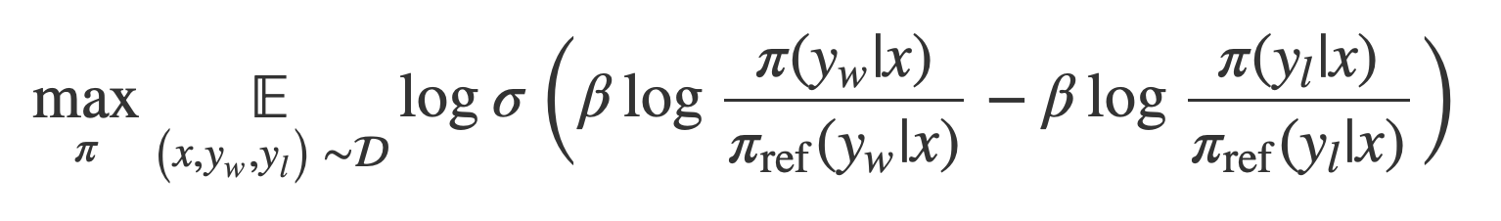
Direct Preference Optimization
Rafailov et al (2023)
Notes:
M

Slide 13
Direct Preference Optimization
good
response
bad
response
(Is pineapple on pizza a crime?, No, Yes)
Rafailov et al (2023)
AIF + DPO: Distilling Zephyr and friends
Notes:
M

Slide 14
Direct Preference Optimization
model we’re optimising
reference
model (SFT)
good
response
Rafailov et al (2023)
AIF + DPO: Distilling Zephyr and friends
Notes:
M

Slide 15
Direct Preference Optimization
model we’re optimising
reference
model (SFT)
bad
response
Rafailov et al (2023)
AIF + DPO: Distilling Zephyr and friends
Notes:
M

Slide 16
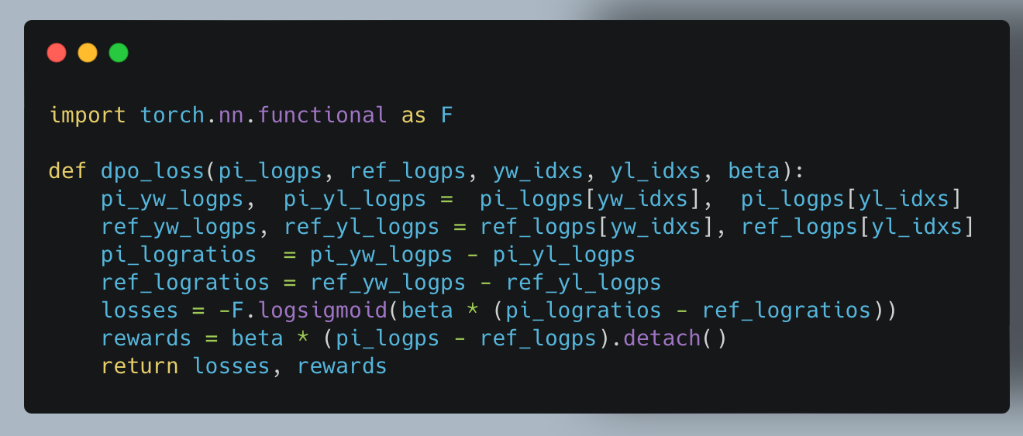
Direct Preference Optimization
Algorithm
Sample good/bad response
Run pairs through 2 models (active and reference)
Backprop
Profit 💪
Rafailov et al (2023)
Notes:
M

Slide 17
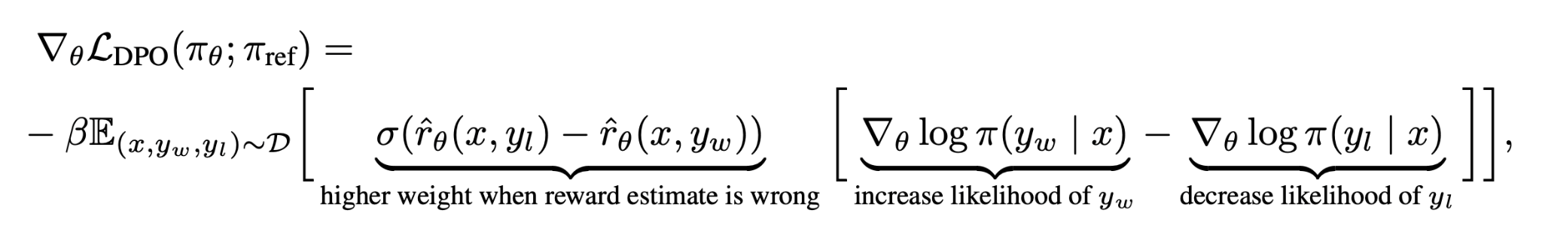
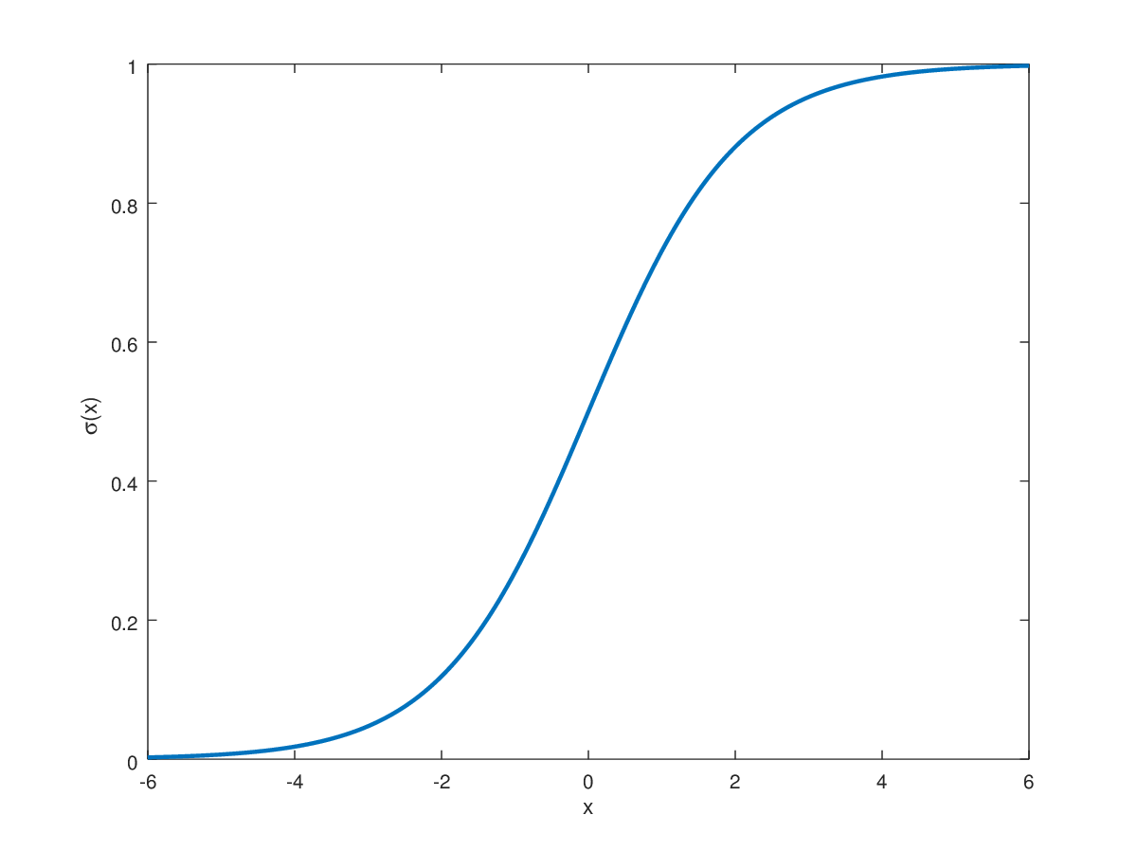
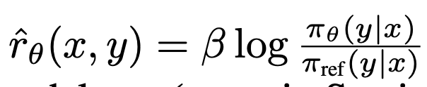
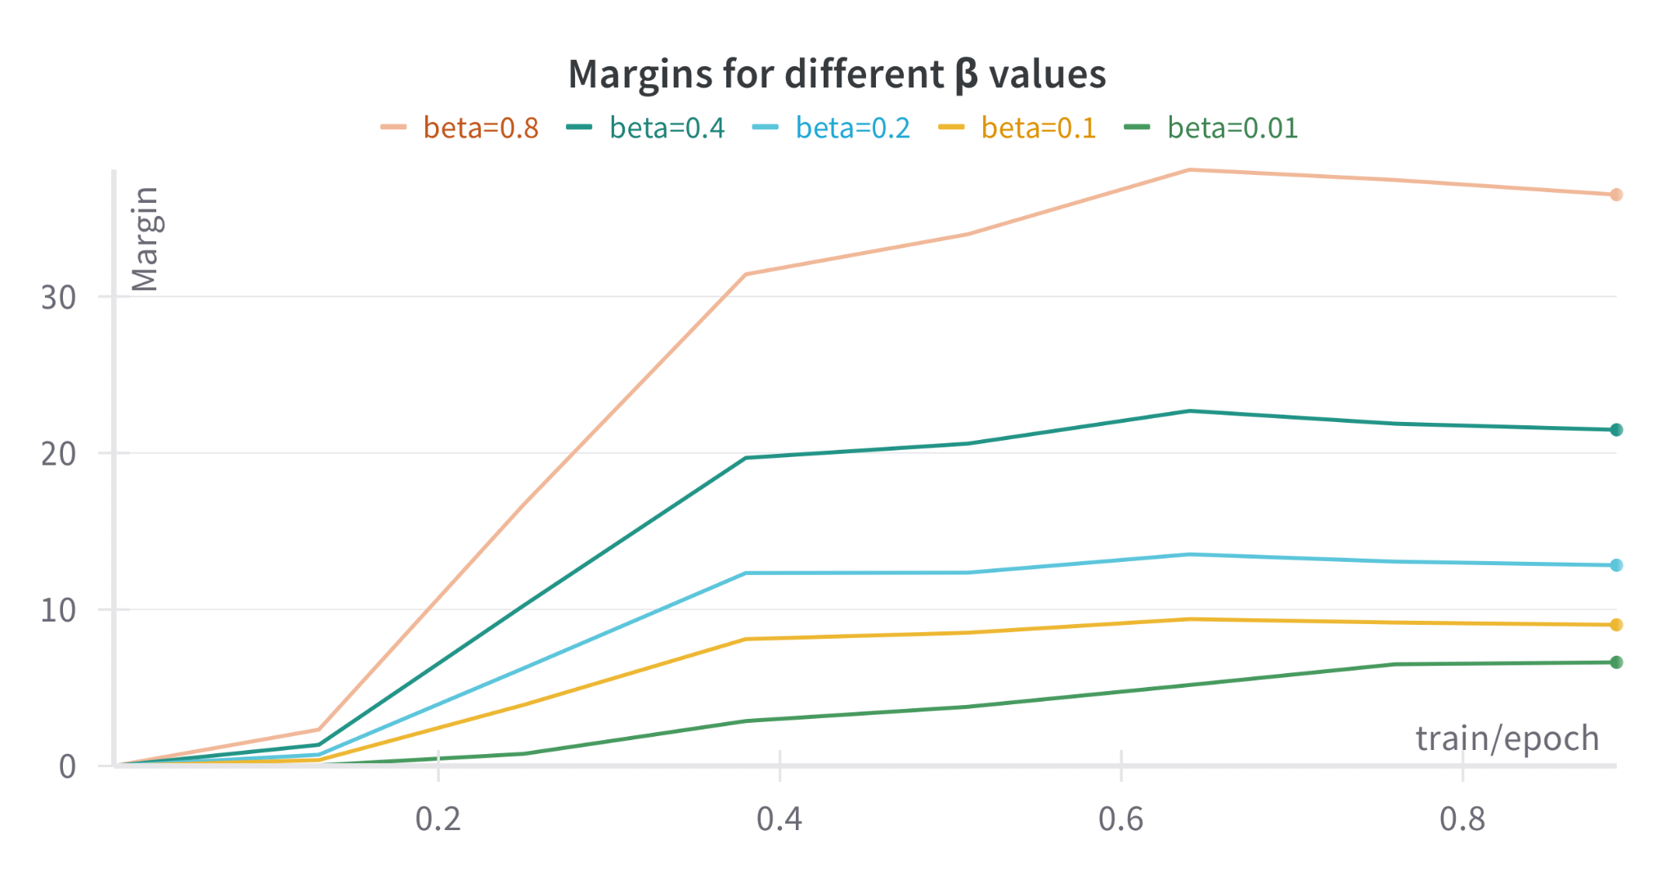
What does the DPO update do?
implicit reward from LM
Notes:
J

Slide 18
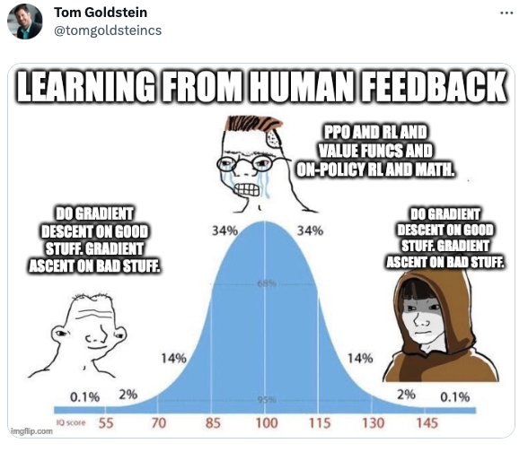
What does the DPO update do?
implicit reward from LM
Notes:
J

Slide 19
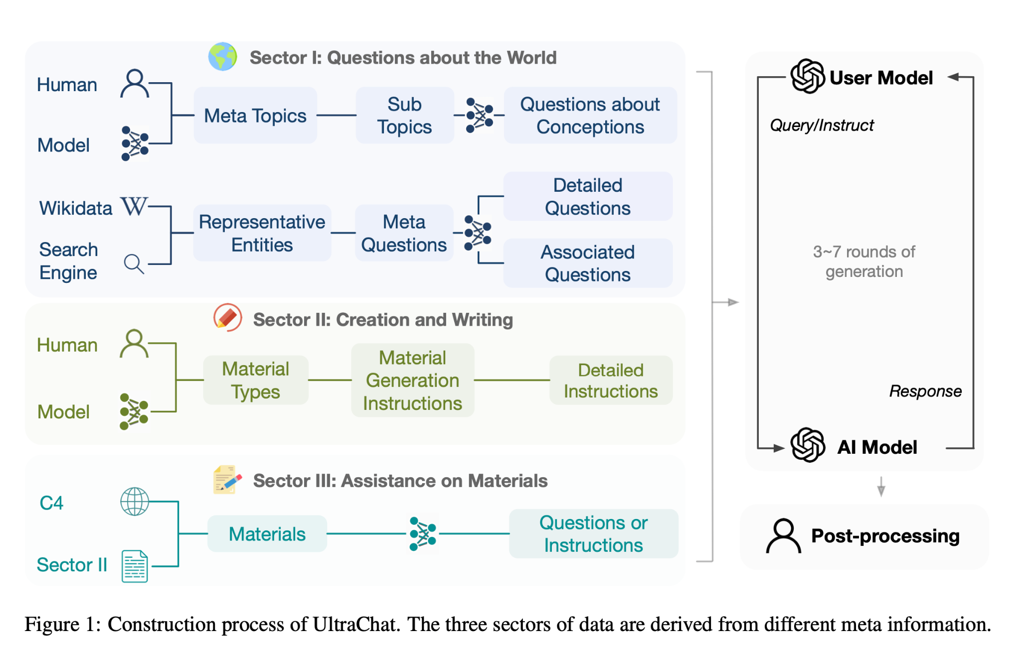
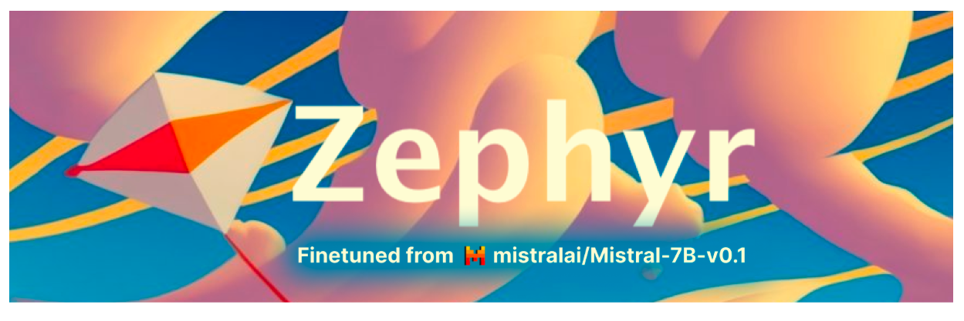
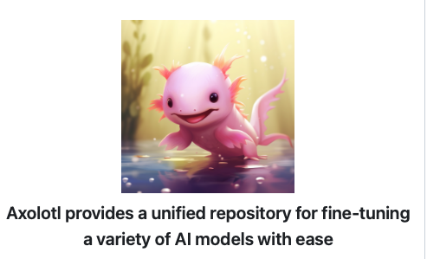
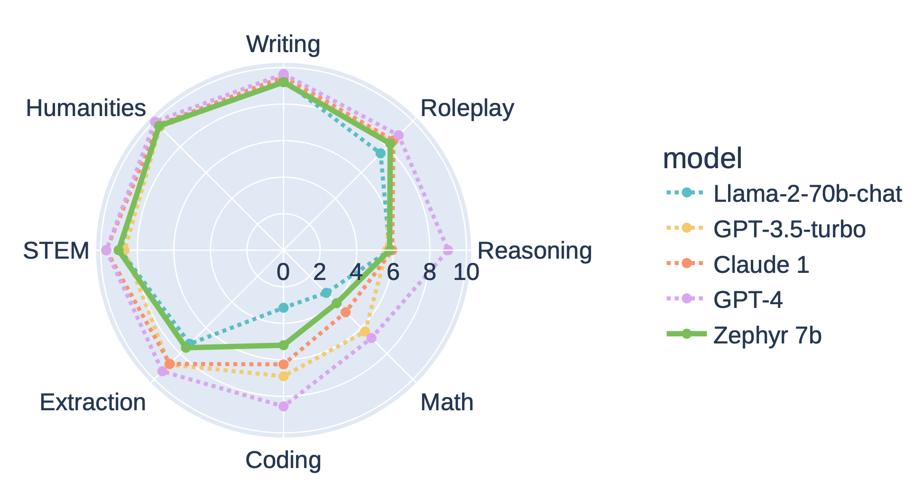
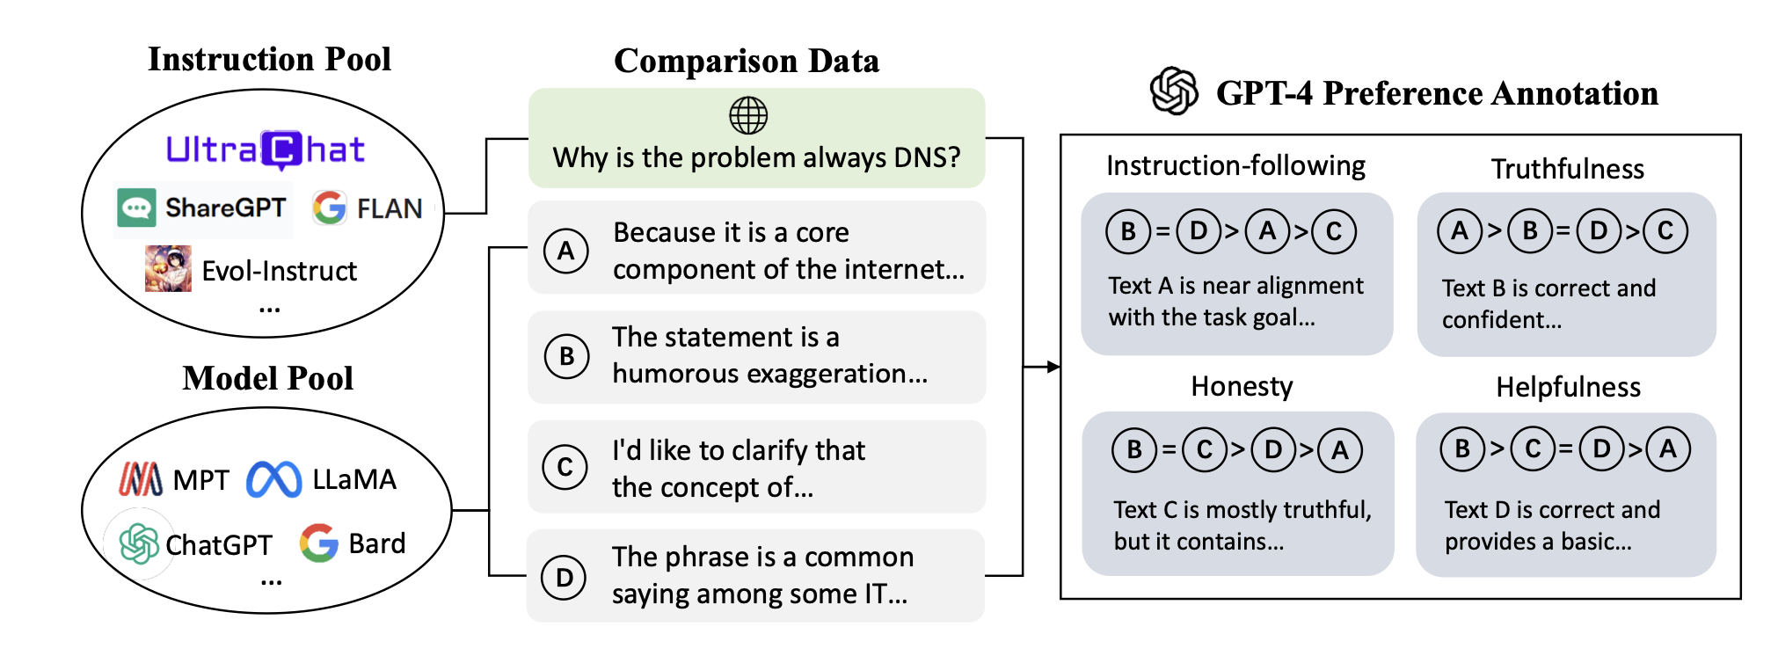
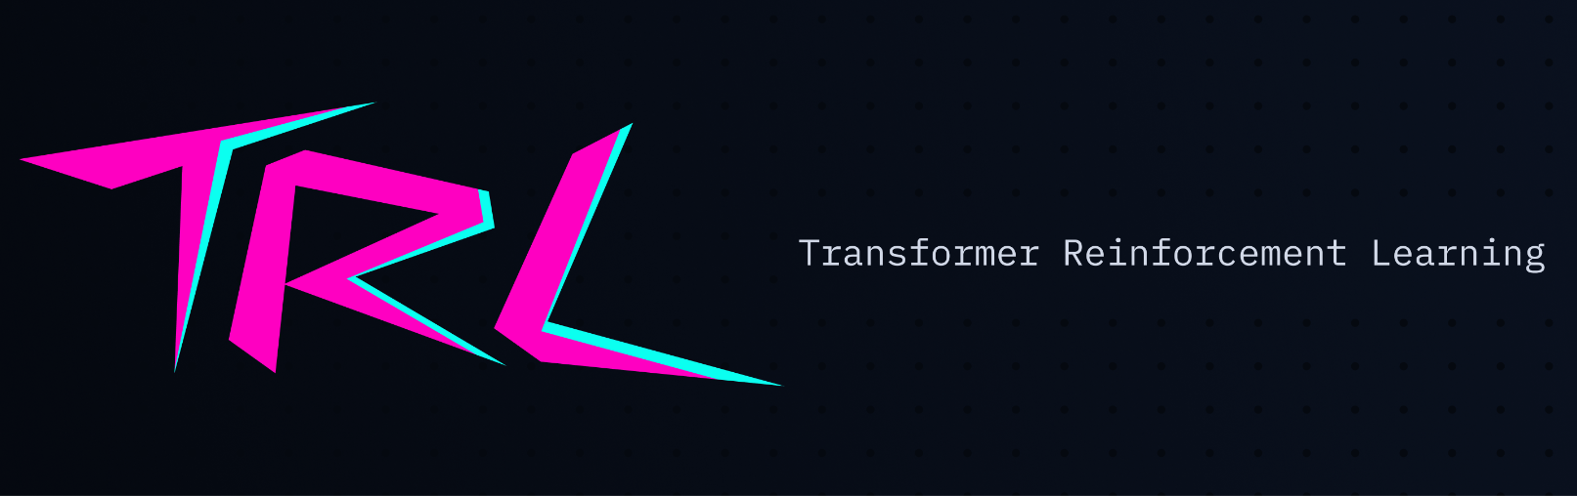
Some examples
UltraChat
for SFT
Ding et al (2023)
UltraFeedback
for DPO
Cui et al (2023)
MT Bench
Tunstall et al (2023)
Notes:
M

Slide 20
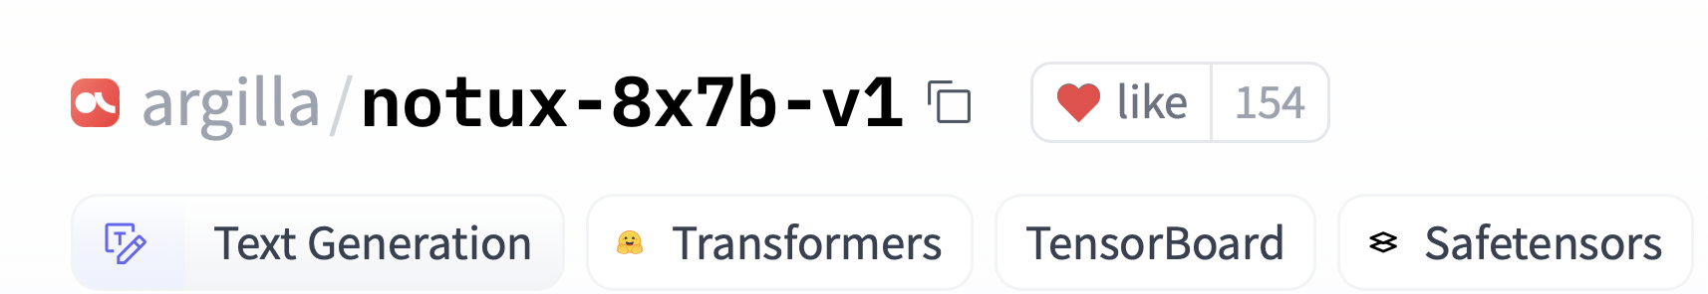
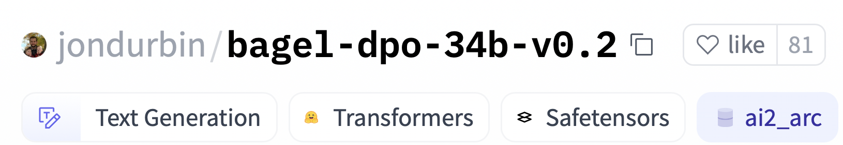
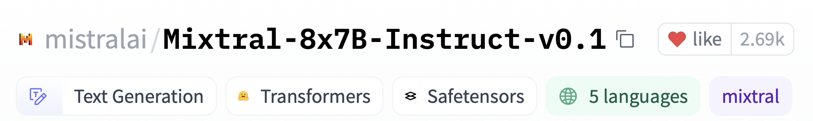
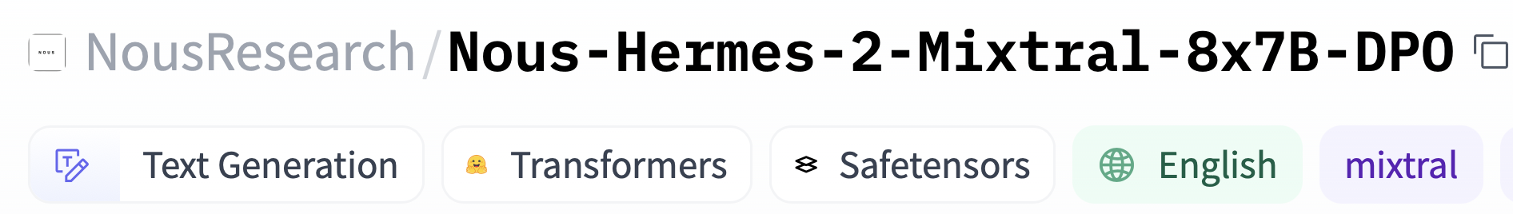
Some examples
huggingface/trl
OpenAccess-AI-Collective/axolotl
Notes:
M

Slide 21
Going beyond DPO
DPO
Iterative DPO
IPO
Snorkel (2023)
Azar et al (2023)
KTO
Combines rejection sampling with DPO
Adds a regularisation term to prevent overfitting
Ethayarajh et al (2023)
Dispenses with binary preferences altogether!
Notes:
M

Slide 22
🙋 Questions?
Notes:
J

Slide 23
Training and Aligning a Chatbot
Practical dive into SFT and DPO
Introduce Chat Templates for formatting dialogue data
Links for SFT and DPO datasets
Metrics
Model Evaluation
Pretraining
Supervised fine-tuning
Alignment
Notes:
J

Slide 24
Annotated SFT & DPO
Notebooks: (runs on colab)
Annotated SFT
Annotated DPO
More up to date codebase: Hugging Face Alignment Handbook
Low-resource examples with Q-LORA
Multi-GPU / node examples with Accelerate & DeepSpeed
Configs, hyper-parameters, slurm scripts
A note on LORA:
PEFT blogpost
LORA paper
Notes:
J

Slide 25
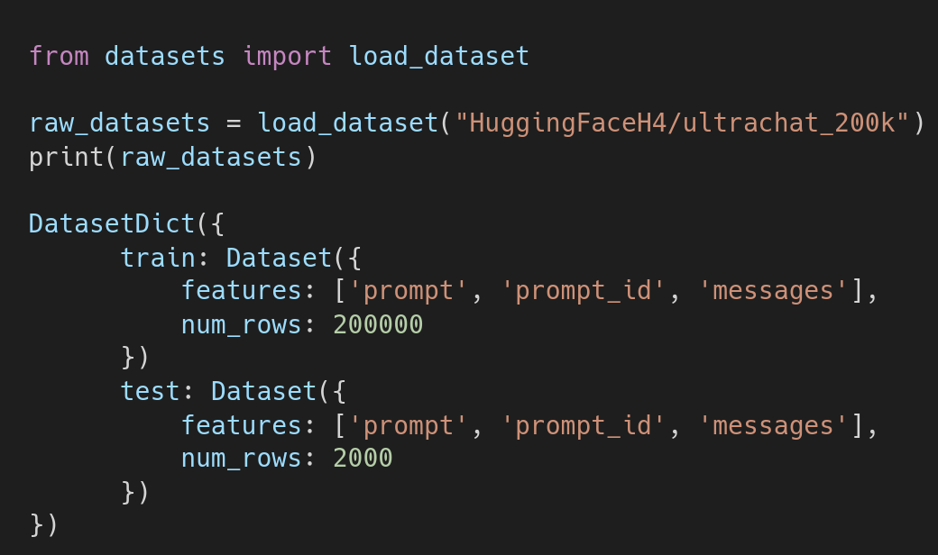
Supervised Fine-Tuning (SFT)
Load a dataset
Apply Chat template
SFT
Notes:
J

Slide 26
Supervised Fine-Tuning (SFT)
Load a dataset
Example prompts:
Which famous landmarks should I visit in London, beyond the usual ones?
Write a program to implement a dynamic programming algorithm for the longest common substring problem in C++
Create a YouTube tutorial on how to bake a gluten-free cake.
Apply Chat template
SFT
Notes:
J

Slide 27
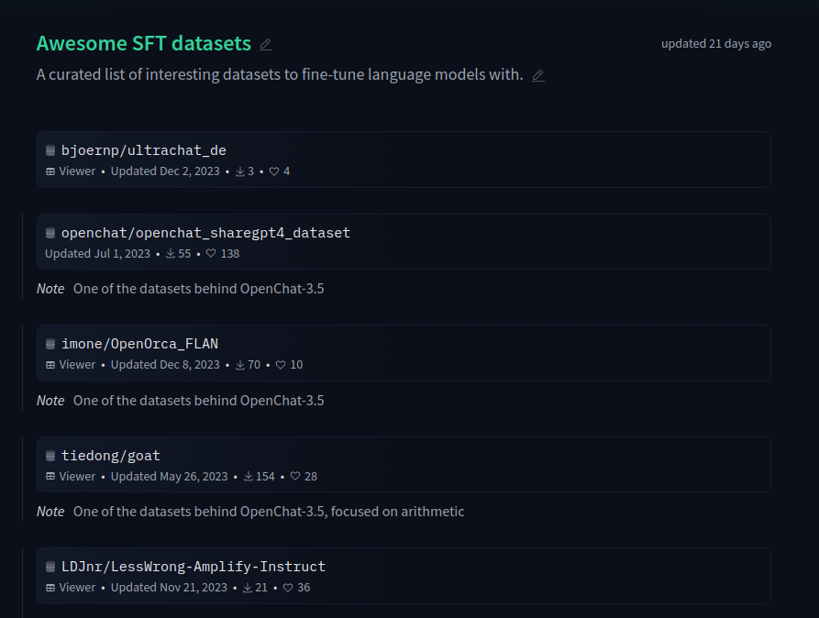
Supervised Fine-Tuning (SFT)
Awesome SFT datasets
Load a dataset
Apply Chat template
SFT
Notes:
J

Slide 28
Supervised Fine-Tuning (SFT)
Popular templates:
ChatML
Llama-2
Zephyr
Load a dataset
Apply Chat template
SFT
Notes:
J

Slide 29
Supervised Fine-Tuning (SFT)
Load a dataset
What is 2+2?
2+2 is equal to 4, how else can I help?
Apply Chat template
What about 5*7?
5*7 is equal to 35, do you have any further questions?
SFT
...
Notes:
J

Slide 30
Supervised Fine-Tuning (SFT)
Load a dataset
<|im_start|>system
<|im_end|>
<|im_start|>user
What is 2+2?<|im_end|>
<|im_start|>assistant
2+2 is equal to 4, how else can I help?<|im_end|>
<|im_start|>user
What about 5*7?<|im_end|>
<|im_start|>assistant
5*7 is equal to 35, do you have an further questions?<|im_end|>
Apply Chat template
SFT

Slide 31
Supervised Fine-Tuning (SFT)
Popular templates:
ChatML <- Recommended
Llama-2
Zephyr
Load a dataset
Apply Chat template
SFT
Notes:
J

Slide 32
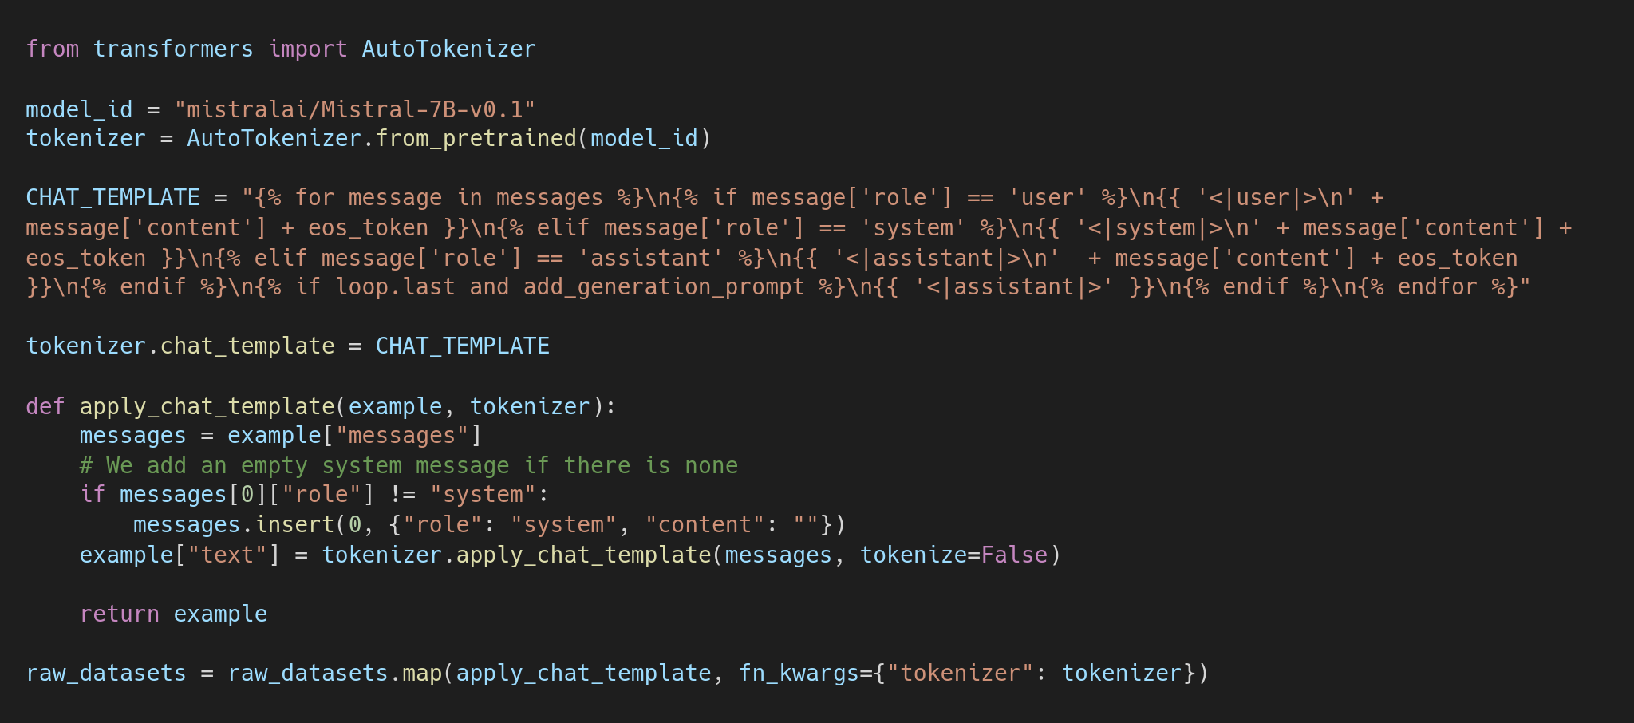
Supervised Fine-Tuning (SFT)
Load a dataset
Apply Chat template
SFT
Notes:
J

Slide 33
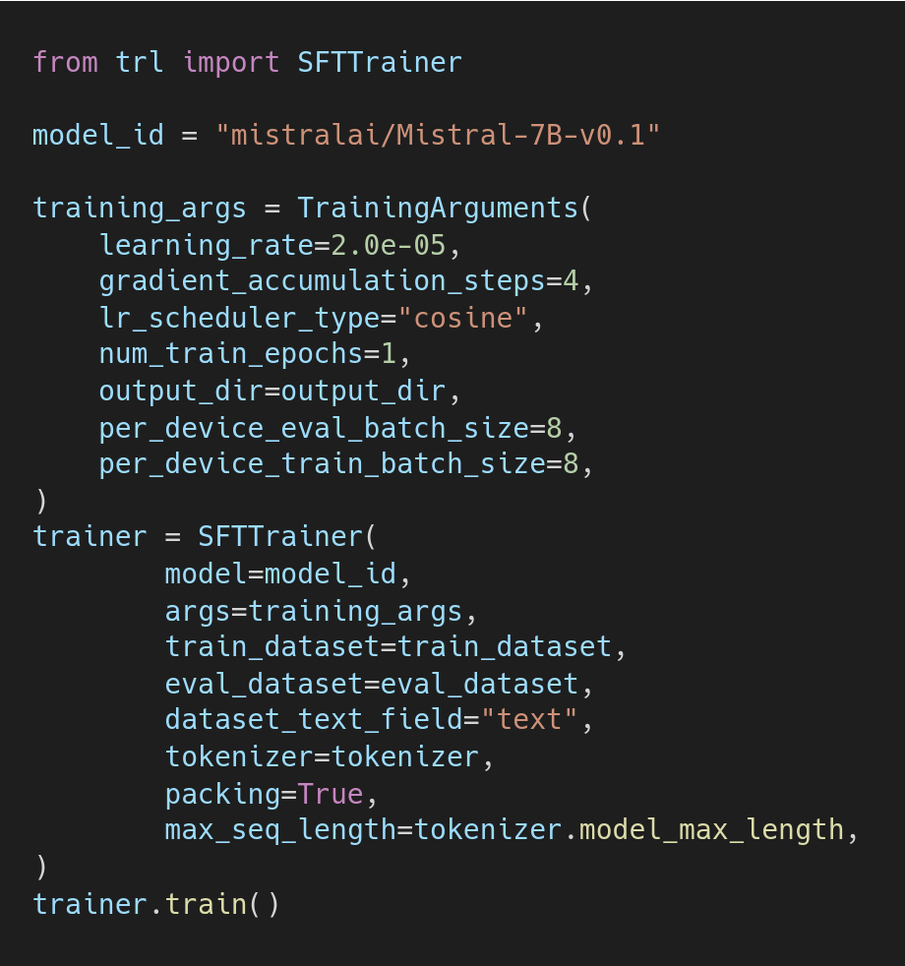
Supervised Fine-Tuning (SFT)
Load a dataset
Apply Chat template
SFT
Notes:
J

Slide 34
Direct Preference Optimization (DPO)
Load a dataset
Apply Chat template
DPO
Notes:
J

Slide 35
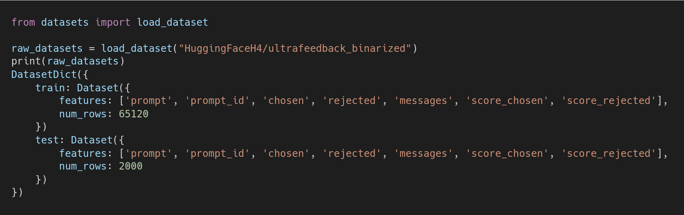
Direct Preference Optimization (DPO)
Load a dataset
Apply Chat template
DPO
Notes:
J

Slide 36
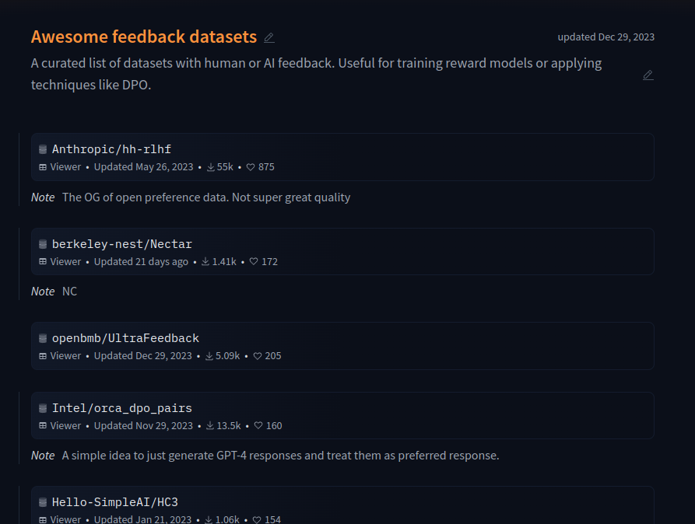
Direct Preference Optimization (DPO)
Awesome feedback datasets
Load a dataset
Apply Chat template
DPO
Notes:
J

Slide 37
Direct Preference Optimization (DPO)
Load a dataset
Prompt (x)
Apply Chat template
Chosen response (y_{w})
Rejected response (y_{l})
DPO
Notes:
J

Slide 38
Direct Preference Optimization (DPO)
Load a dataset
Prompt (x)
Apply Chat template
Chosen response (y_{w})
Rejected response (y_{l})
DPO
Notes:
J

Slide 39
Direct Preference Optimization (DPO)
Load a dataset
Prompt
Apply Chat template
Response 1
Response 2
Response 3
Response 4
DPO
Where:
Pref(R1) > Pref(R2) > Pref(R3) > Pref(R4)
Notes:
J

Slide 40
Direct Preference Optimization (DPO)
Load a dataset
Prompt
Assistant reponse
Apply Chat template
User response
DPO
Chosen response
Rejected response
Notes:
J

Slide 41
Direct Preference Optimization (DPO)
Load a dataset
Prompt
Prompt
Assistant reponse
Assistant reponse
Apply Chat template
User response
User response
DPO
Chosen response
Rejected response
Notes:
J

Slide 42
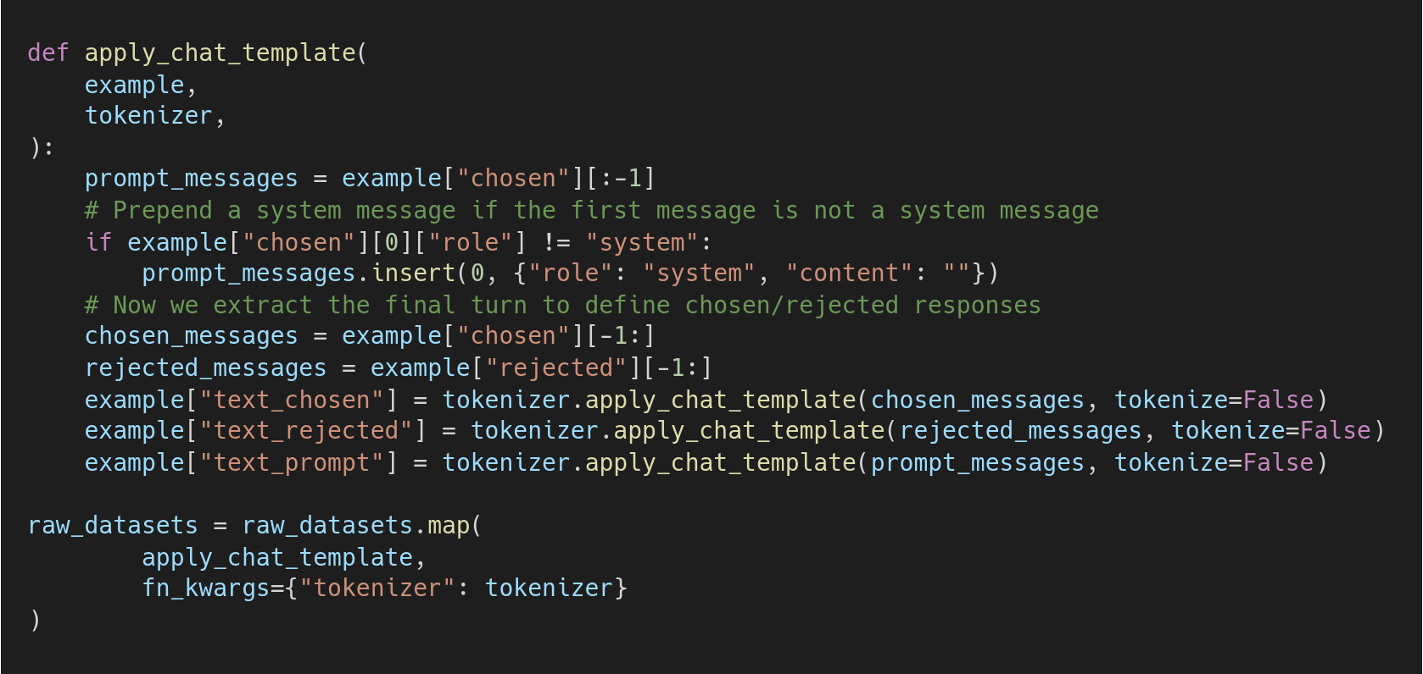
Direct Preference Optimization (DPO)
Load a dataset
Apply Chat template
DPO
Notes:
J

Slide 43
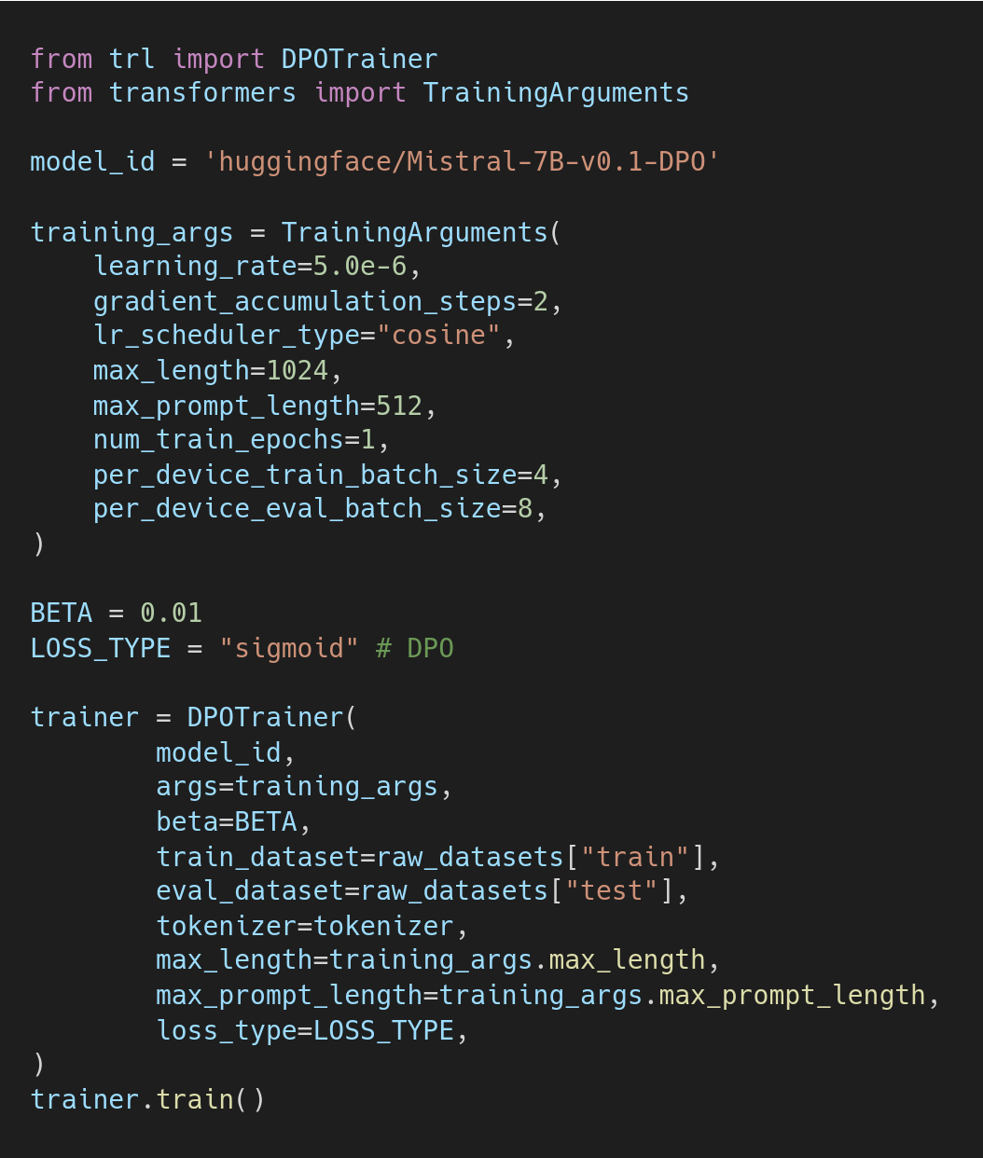
Direct Preference Optimization (DPO)
Load a dataset
Apply Chat template
DPO
Notes:
J

Slide 44
Direct Preference Optimization (DPO)
Load a dataset
Apply Chat template
DPO
More on beta and Alignment losses: https://huggingface.co/blog/pref-tuning
Notes:
J

Slide 45
Direct Preference Optimization (DPO)
Load a dataset
Apply Chat template
DPO
Notes:
J

Slide 46
DPO Training tips
Beta: test from 0.01 - 1.0
Learning rate: much smaller than for SFT ~100x smaller (5E-7)
Batch size: tradeoff between global batch size and n epochs
Optimizer: Adam appears better than RMSProp
Scheduler: Cosine > Linear
The best SFT model != Best DPO model
LoRA: Appears to regularize the model compared to full fine-tune
Notes:
J

Slide 47
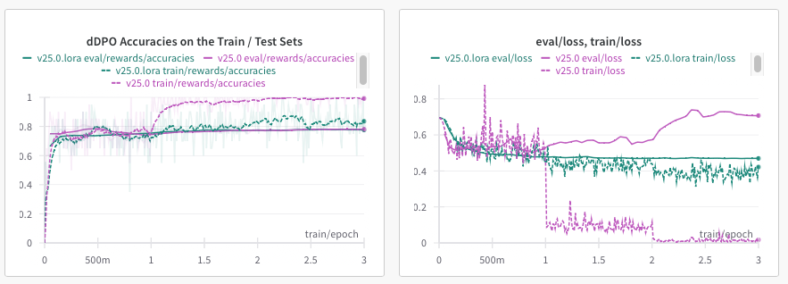
DPO Training tips
Beta
Learning rate (much smaller than for SFT) ~100x smaller
Batch size tradeoff between global batch size and n epochs
Optimizer: Adam appears better than RMSProp
Scheduler: Cosine > Linear
LoRA: Appears to regularize the model training compared to full fine-tuning
Notes:
J

Slide 48
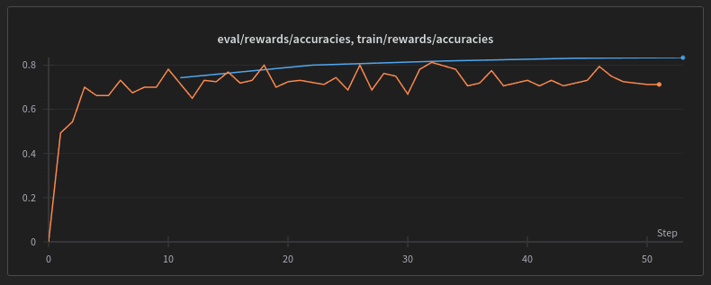
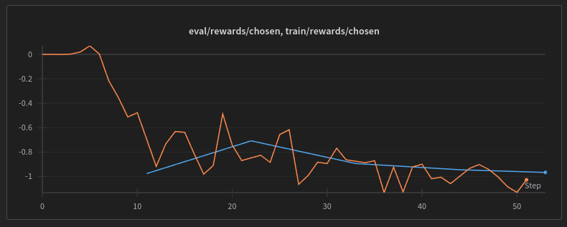
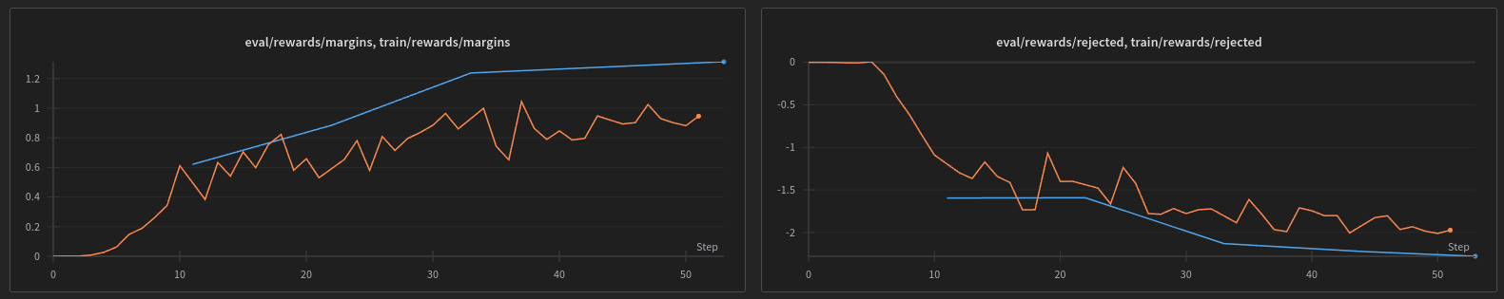
DPO Metrics
Notes:
J

Slide 49
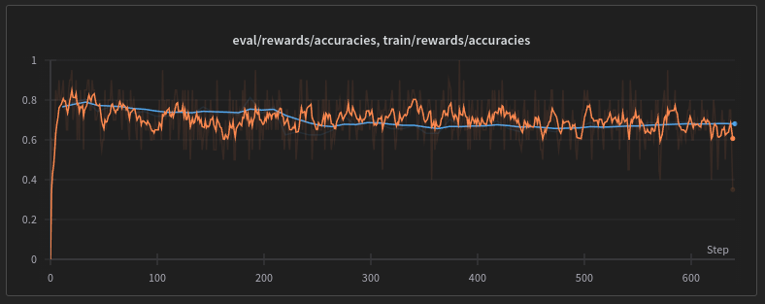
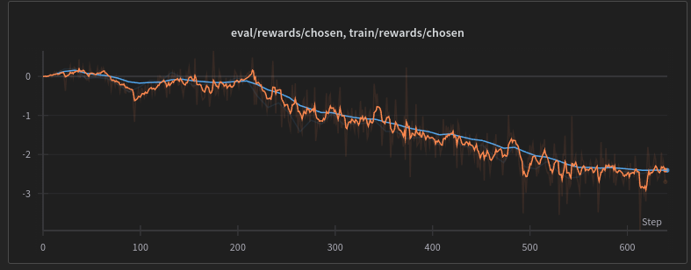
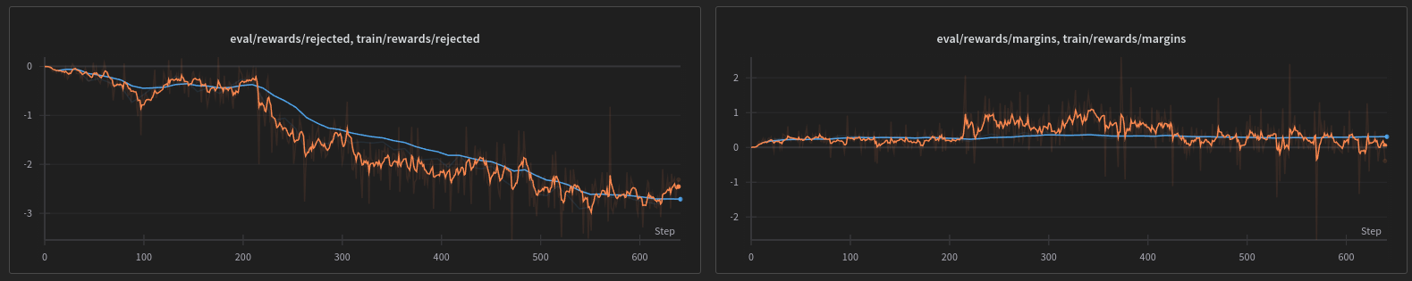
Diagnosing problems
Notes:
J

Slide 50
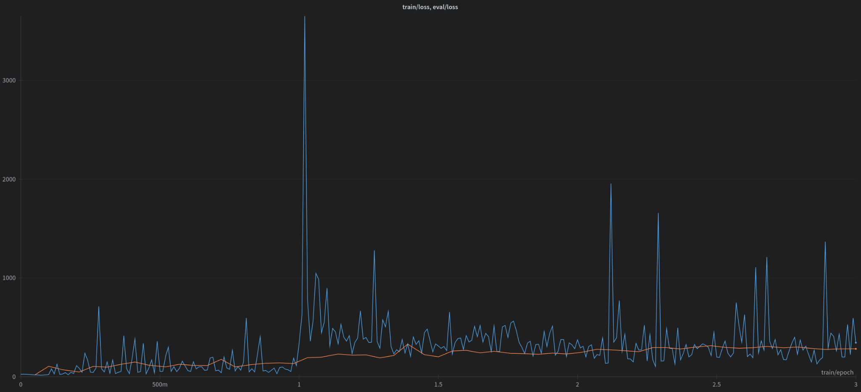
Diagnosing problems
Notes:
J

Slide 51
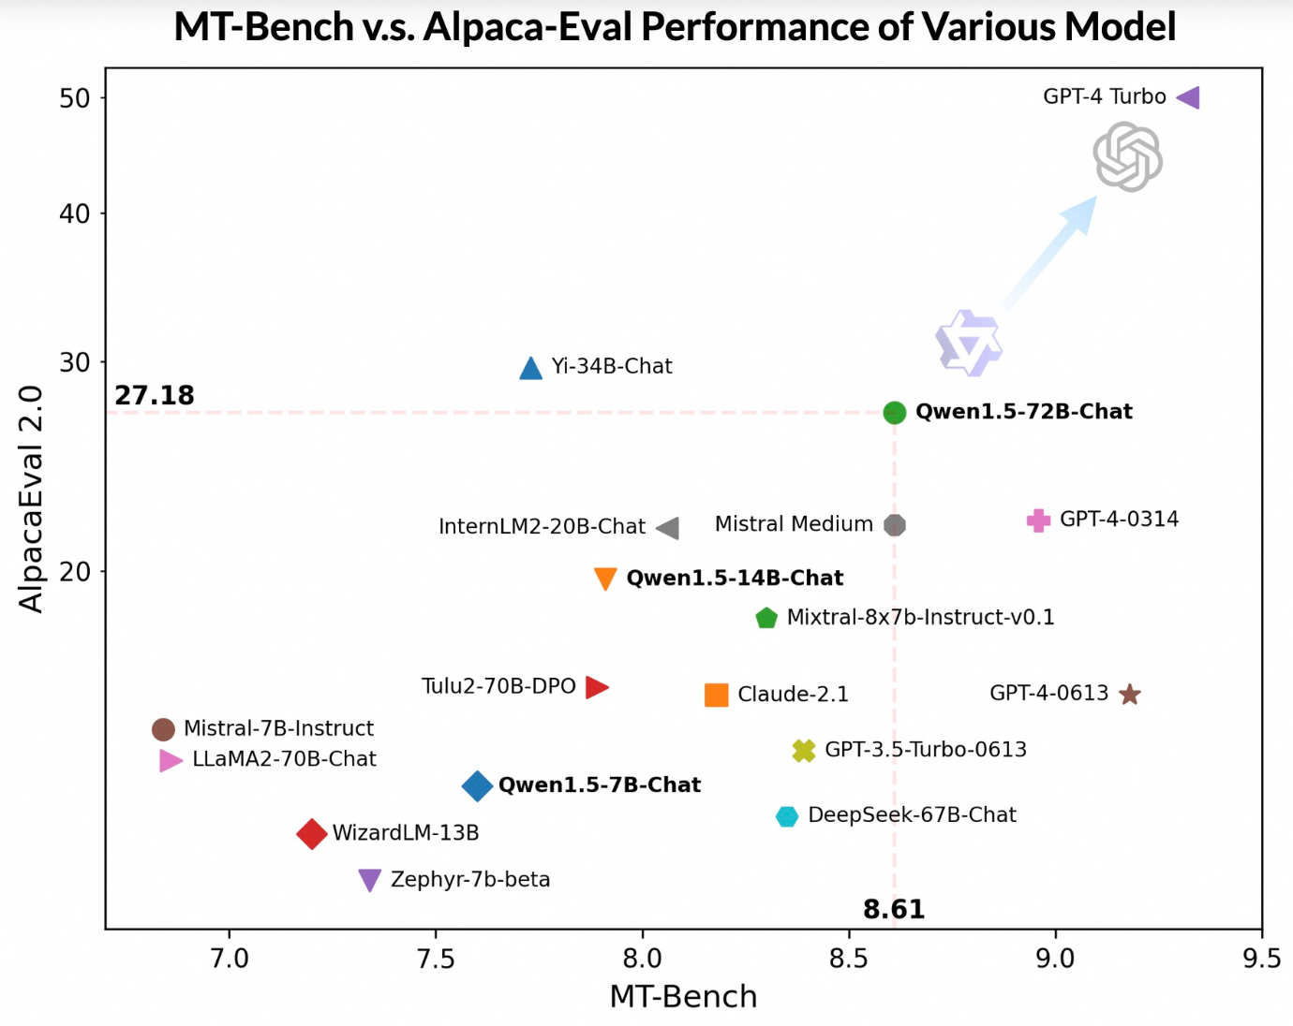
Evaluating Chatbots
https://qwenlm.github.io/blog/qwen1.5/
Notes:
J

Slide 52
Evaluating Chatbots
OpenLLM LeaderBoard - Not Chatbot focused, leakage, overfitting
MT Bench - Usage
Alpaca Eval - Usage
LLamaindex (RAG)
Human Eval - Lmsys Chatbot Arena
Notes:
J

Slide 53
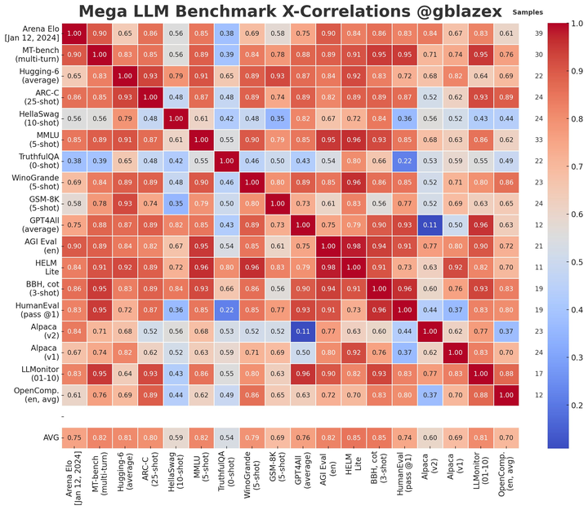
Benchmark correlations
Notes:
J

Slide 54
🙋 Questions?
Notes:
J

